Slide 1
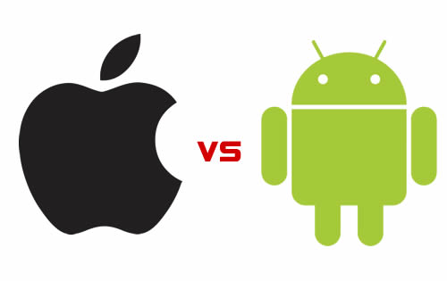
Mohammed Alhusein

Slide 2
Outline
Competition
Development
Publishing

Slide 3
Competition

Slide 4
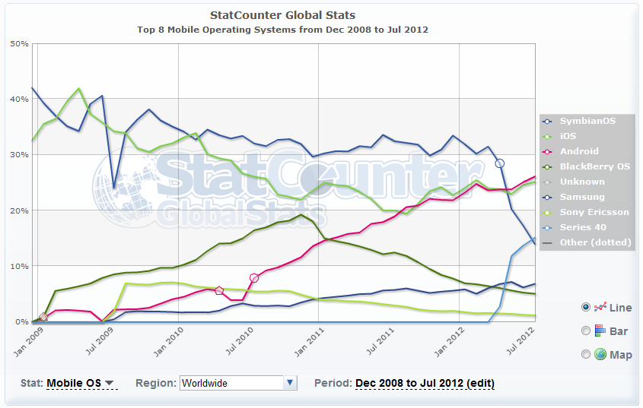
OS Market Share (World)

Slide 5
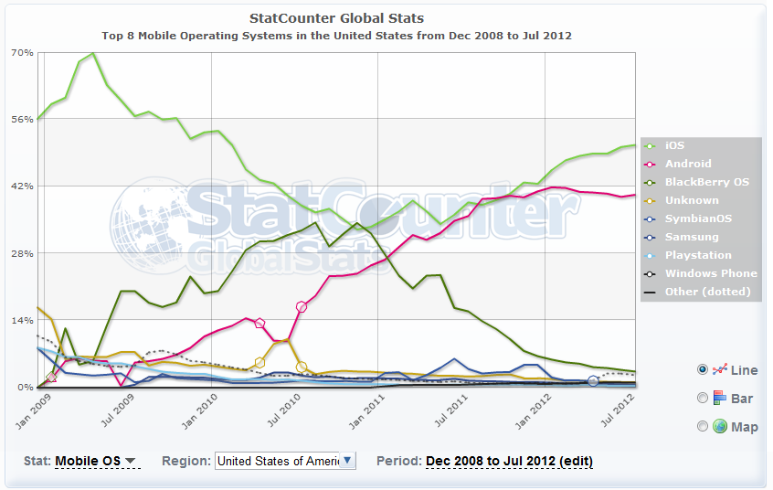
OS Market Share (USA)

Slide 6
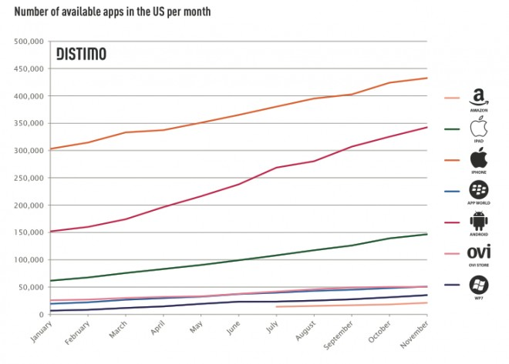
# of Available Apps

Slide 7
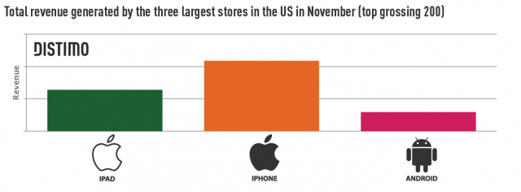
Total App Sales Revenue
iOS = 6 x Android
Ease of purchase: Checkout vs. iTunes
93% iOS users have iTunes accounts with credit card info.
Google encourages free stuff.

Slide 8
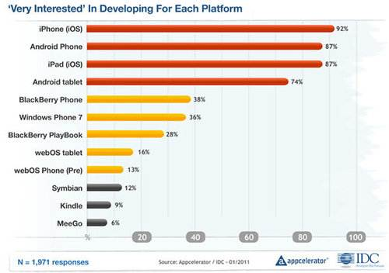
Developers’ Interest

Slide 9
Development

Slide 10
Programming Language
Android OS: Java
iOS: Objective C
NSArray * foo = [[NSArray alloc] initWithObjects:@"foo",@"bar",@"baz",nil];

Slide 11
Development Platform
Android OS:
open platform, allowing the use of 3rd party tools
Key to OS success
can reach core components. More like PC swr
iOS:
Restrictive guidelines
Fixed set of tools, nothing outside, nothing deep
No Flash!

Slide 12
Multitasking Abilities
Android OS:
Very versatile → dynamic
Highly fragmented → challenging
In USA: 80 Android models vs. 9 iOS models
Poor battery performance
Best notification system (e.g. emails)
iOS:
Stable and exclusive platform
Fixed set of tools, with clear potential and boundaries → easier

Slide 13
Security
Android OS:
Access control, isolation, web security
Encryption
Permission-based access control:
Static list in manifest
User presented with list at installation time
Wild West app marketplace.
Nearly any app is allowed to market
Android-specific malware

Slide 14
Security
iOS:
Access control, isolation, web security
Encryption
Permission-based access control:
Dialog box at run time.
Geolocation
Auto Erase

Slide 15
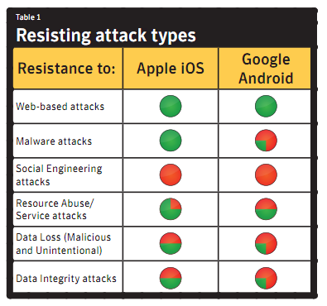
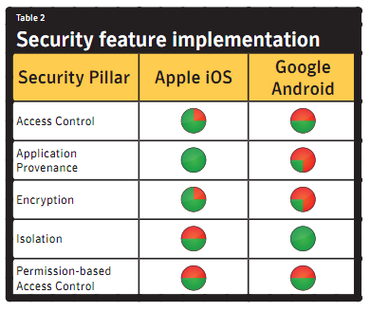
Security
Semantic

Slide 16
OS Upgrades
Android OS:
Millions of phones under contract cannot be updated
0.4% run the latest version
iOS:
Apple disallows old devices to update →permanently vulnerable to easy attacks
~90% run one of the two latest versions

Slide 17
Publishing

Slide 18
App Approval
Android OS:
Very quick!
iOS:
Days.. and days.. and days..
Many restrictions

Slide 19
Payments and Availability
Android OS:
Developer pays $25 one time
Developer earns 70% of revenue
Several Stores: Google Play, Amazon…
Paid apps available in 132 countries
No screenshots of apps, only short descriptions

Slide 20
Payments and Availability
iOS:
Developer pays $99 annually
Developers earns 70% of revenue
App Store only
Paid apps available in 155 countries
5 screenshots and description

Slide 21


Which is Better?
OS Mkt Share
# of Apps
Revenue
Developer Interest
Easiness of PL
Platform
Multitasking
Security
OS Upgrades
App Approval
Payments & Avail.

Slide 22
Sources
http://www.technolog.msnbc.msn.com/technology/technolog/android-iphone-its-two-horse-race-125203j
http://gs.statcounter.com/#mobile_os-ww-monthly-201106-201206
http://mobiledevices.about.com/od/kindattentiondevelopers/tp/Android-Os-Vs-Apple-Ios-Which-Is-Better-For-Developers.htm
http://www.wired.com/gadgetlab/2011/12/ios-revenues-vs-android/
http://www.callingallgeeks.org/34829/android-vs-ios-pros-and-cons/
http://www.lunawebs.com/blog/2012/03/18/android-vs-ios-the-pros-and-cons-of-two-app-platforms-825/
http://www.techtricksworld.com/2011/11/choosing-between-android-and-ios-a-developer%E2%80%99s-guide.html’
http://techsbot.com/android-vs-ios-pros-and-cons/
http://www.youtube.com/watch?v=OvdjXZnbC-o

